Slide 1
System panic week 3
Aleksander m.
Antony p.
Layla h.

Slide 2
Changes
Changed the look of the dungeons
Added lighting and updated intersections
3 Enemies were added into the game
Character Animations
Code Refactor and changing attributes

Slide 3
GENERATION

Slide 4


Slide 5
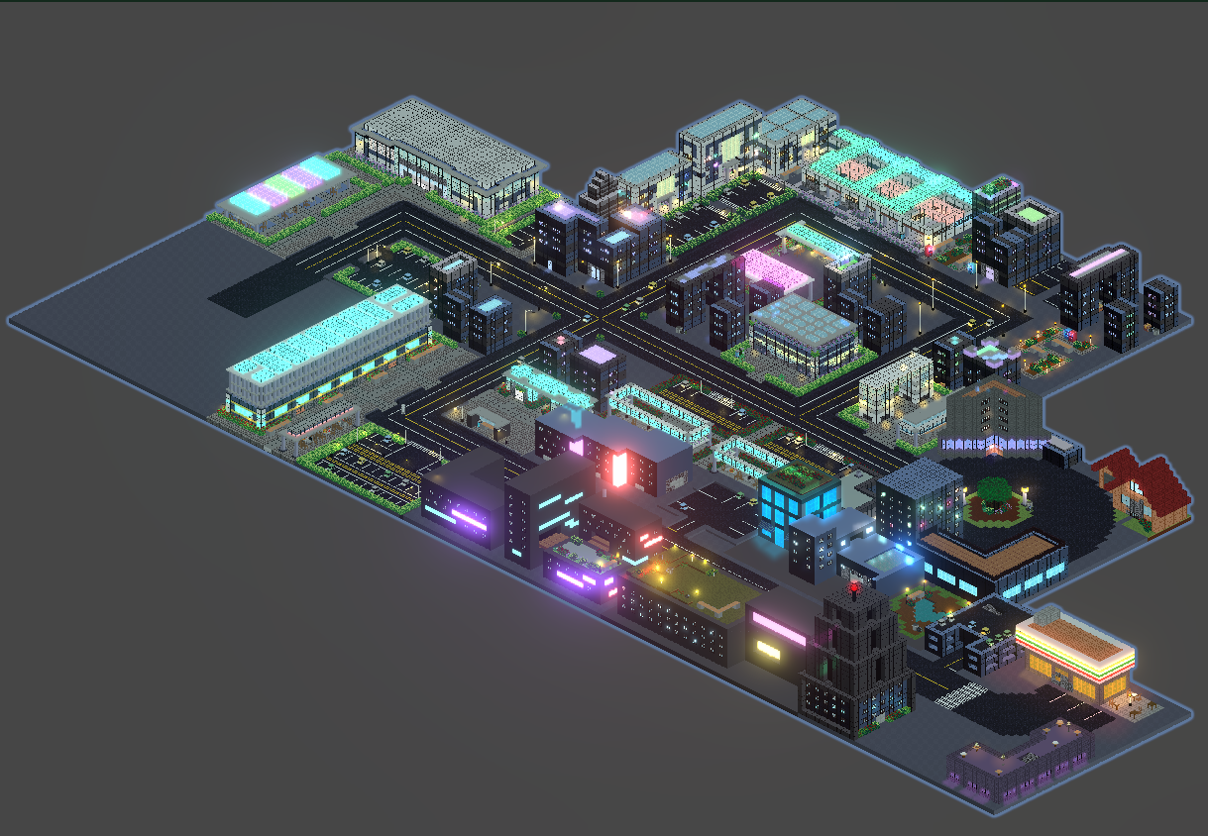
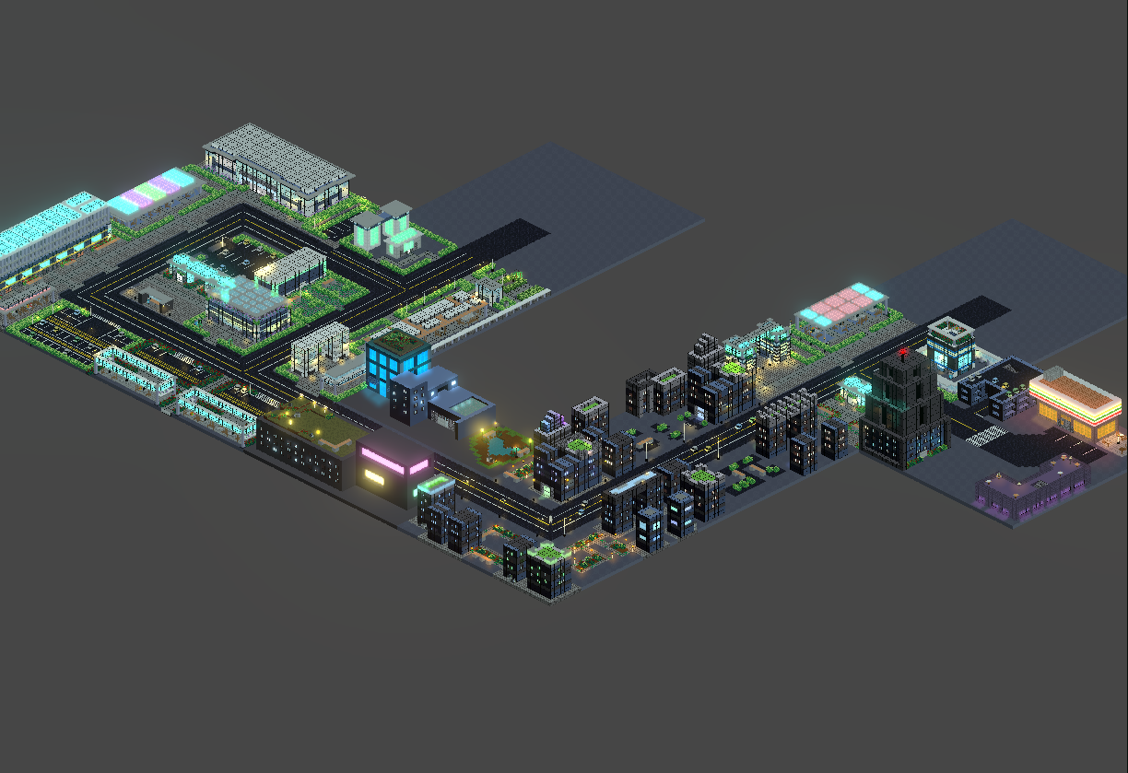

Slide 6
In-game

Slide 7
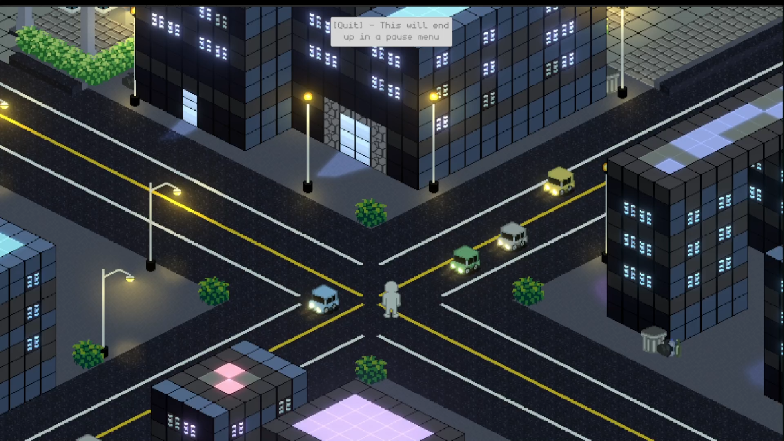

Slide 8
new intersections

Slide 9
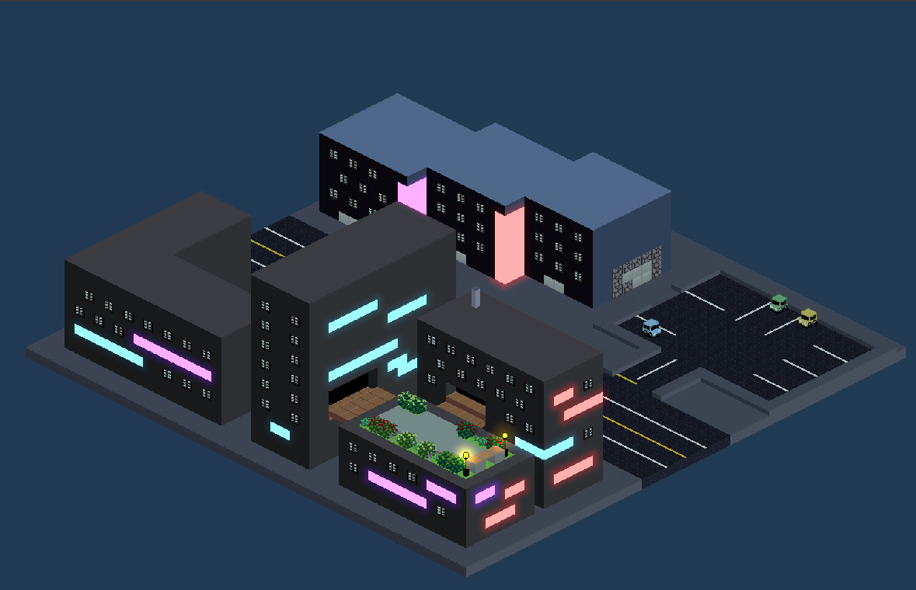
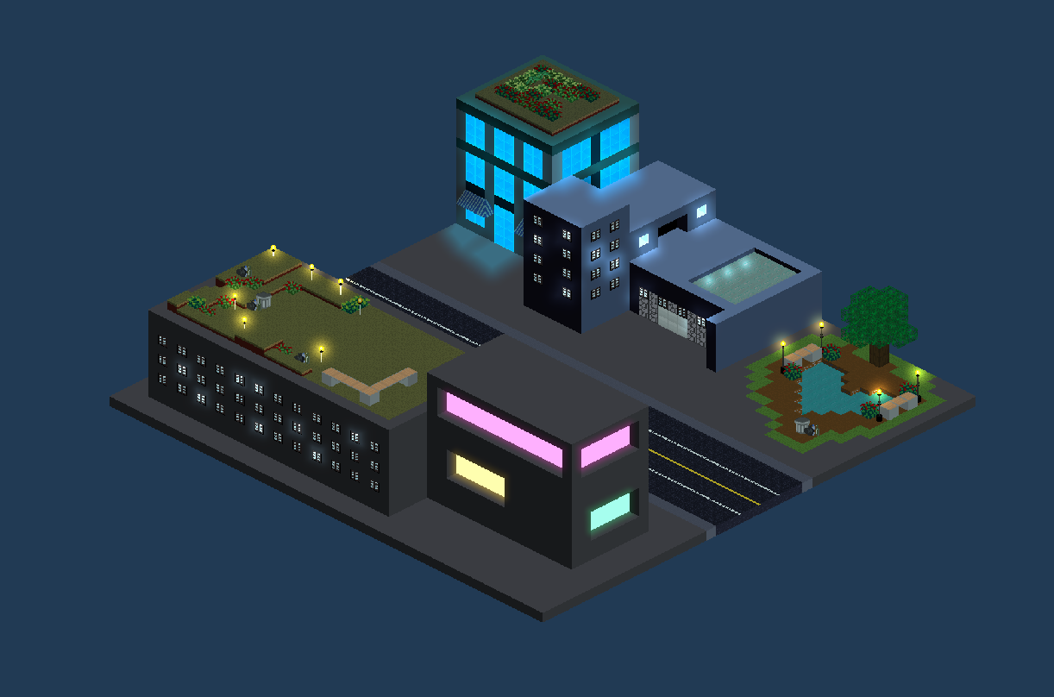
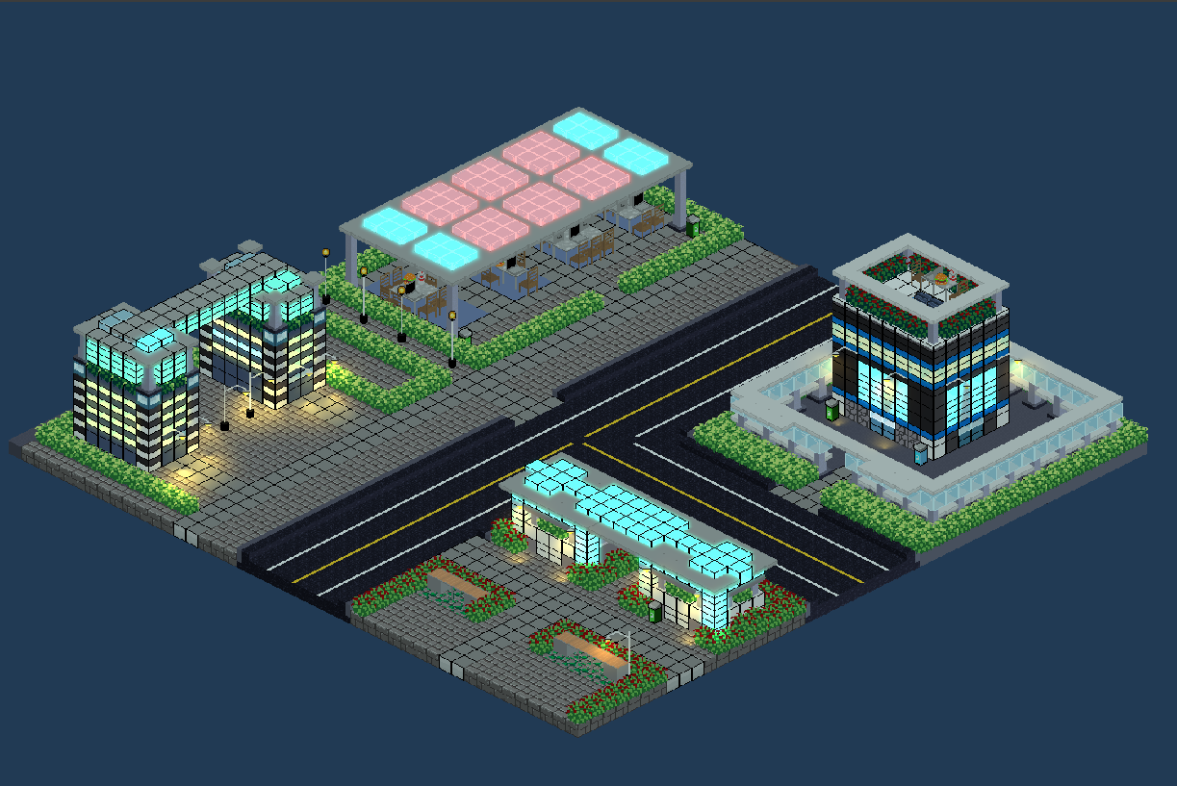
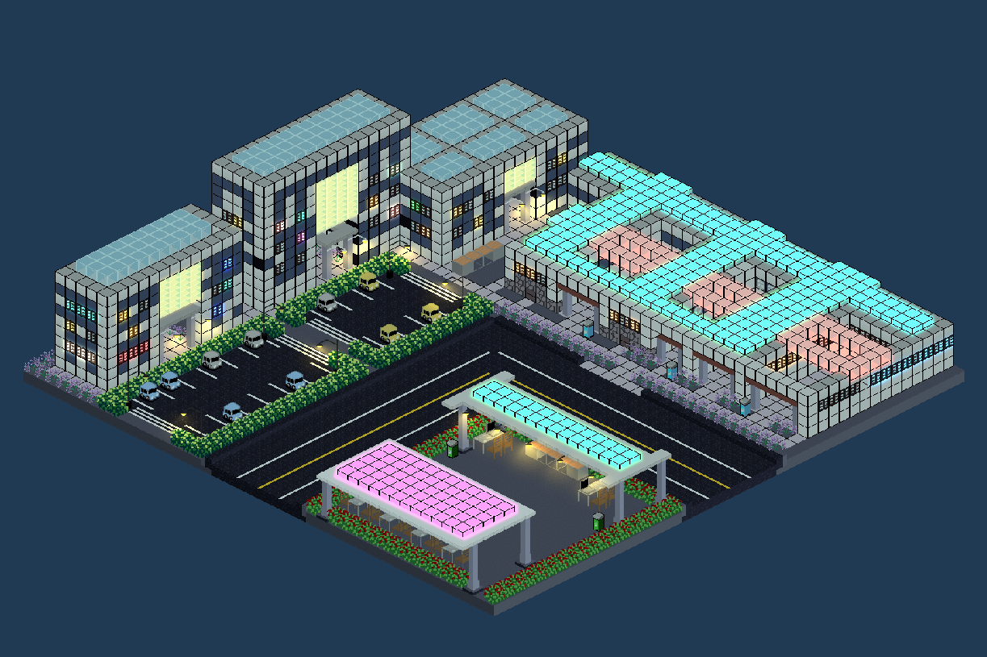

Slide 10
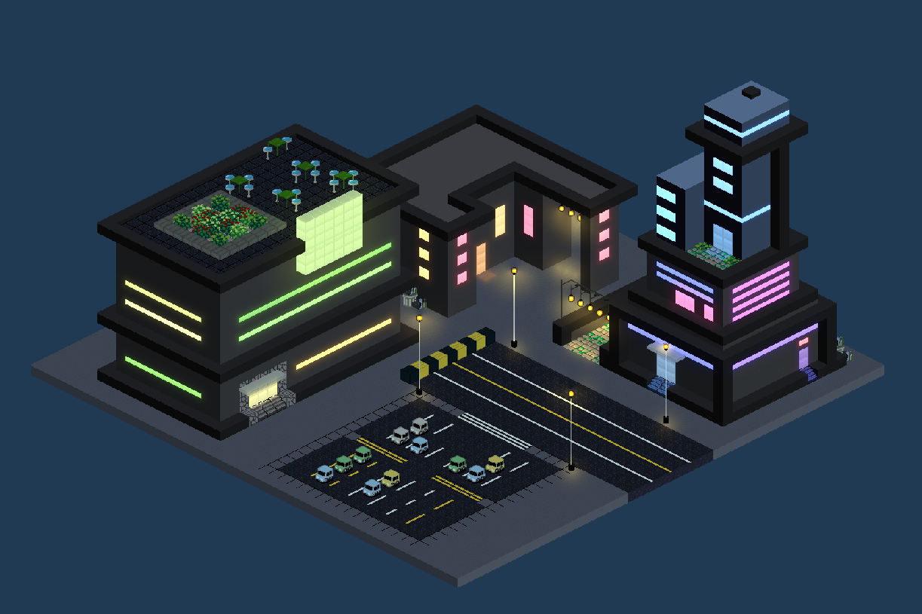
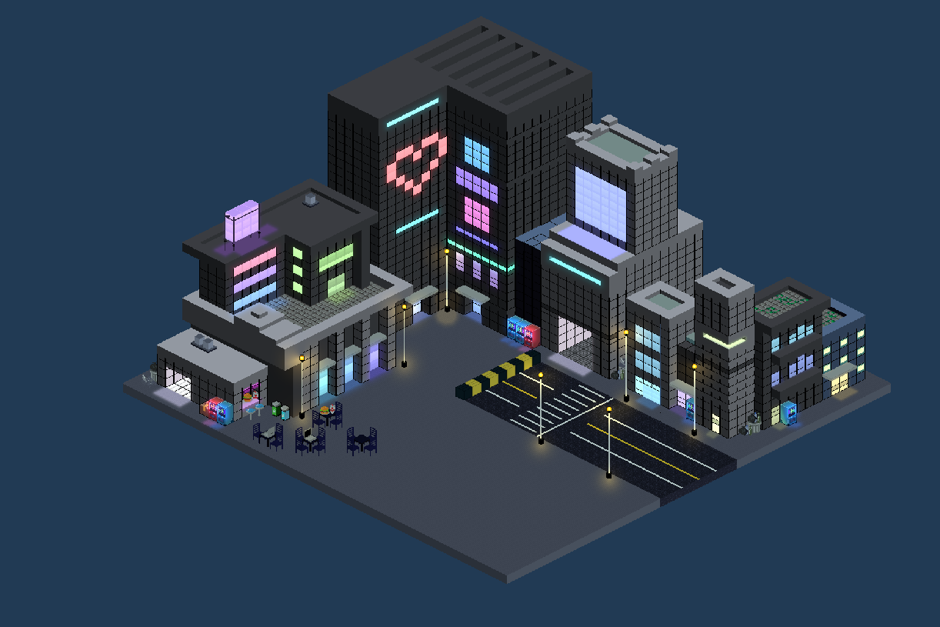
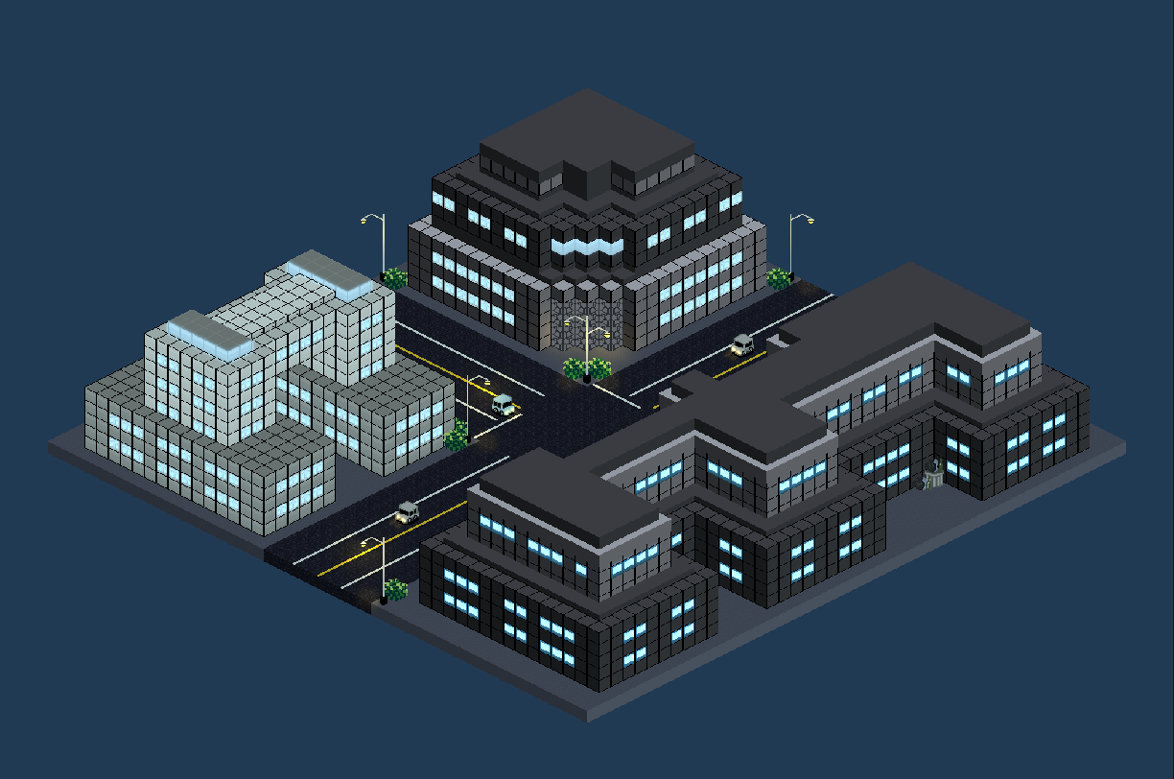
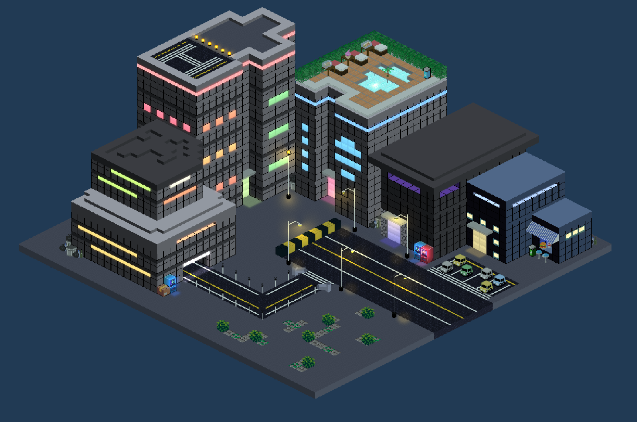

Slide 11
dungeons

Slide 12
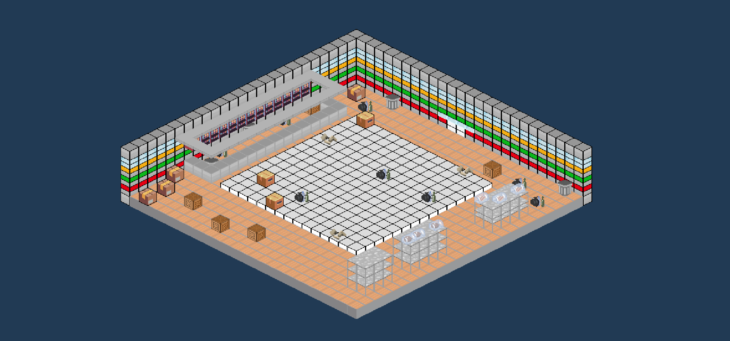
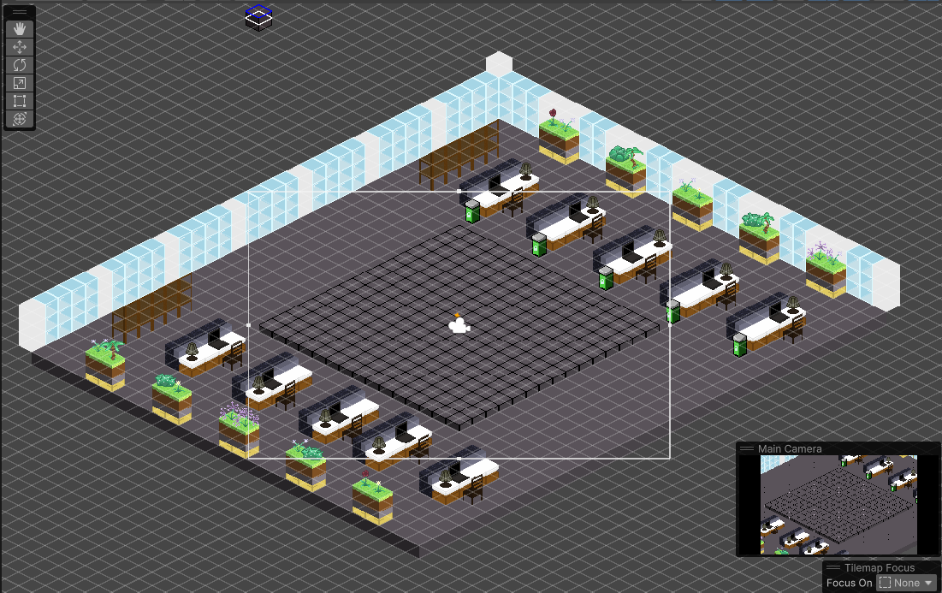
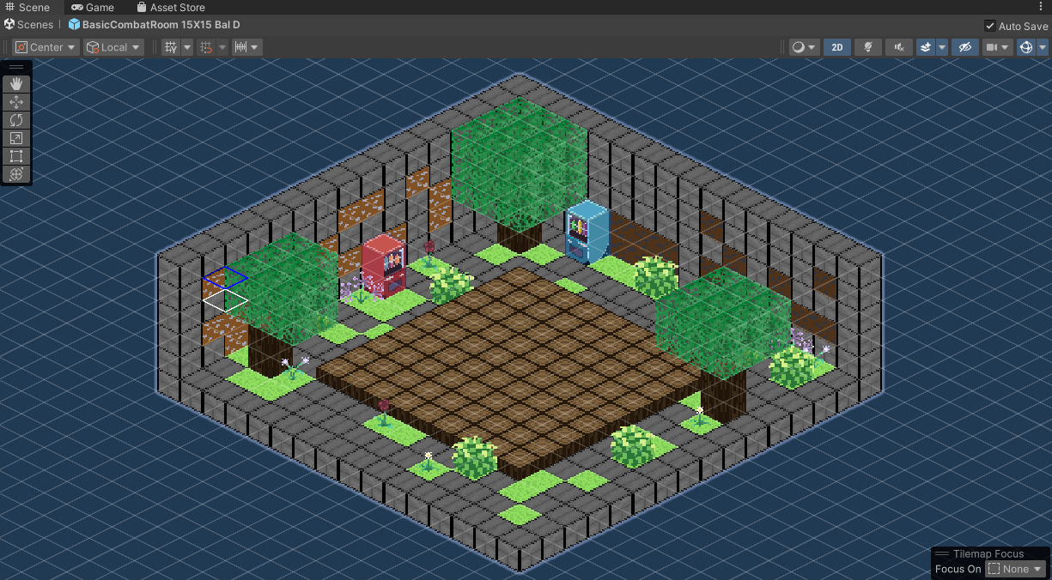

Slide 13
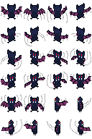
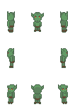
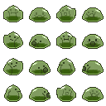
Enemies
Slime – “Acid Spit”
Bat
Goblin

Slide 14
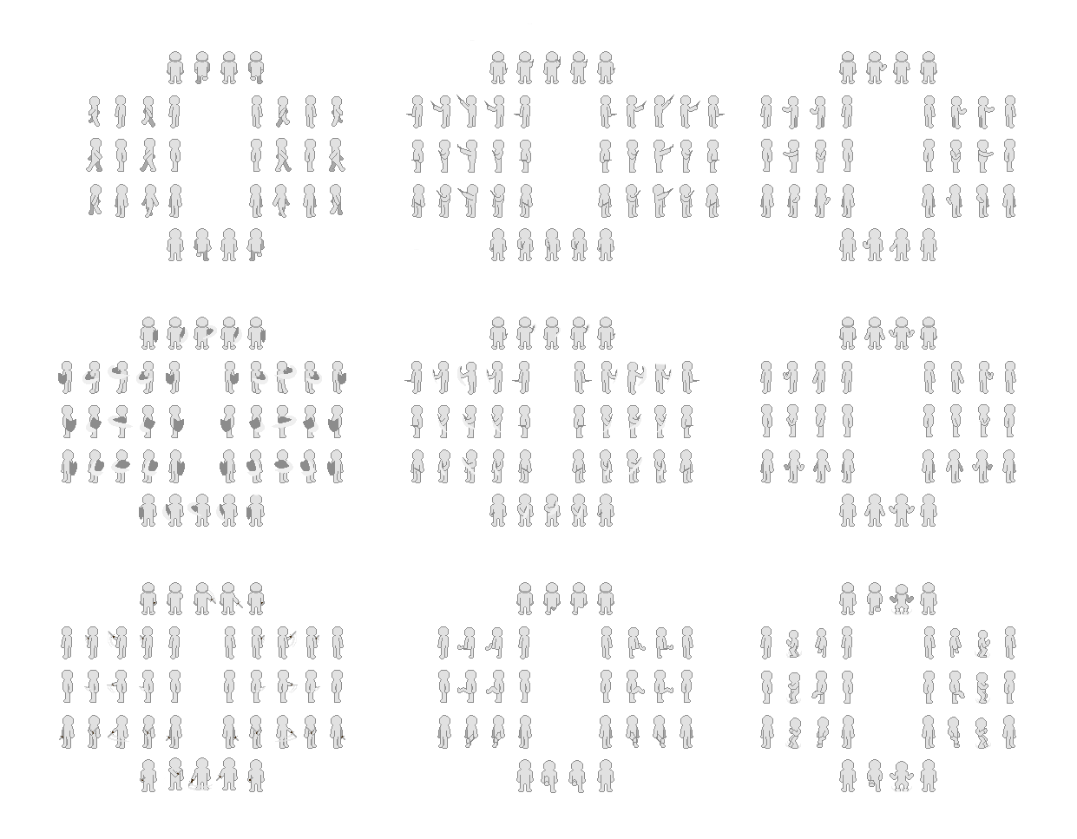
Character Animations
Fixed Walk
Wand
Spell Cast
Dagger
Swing
Shield Bash
Berserk
Sword
Swing
Ground
Slam
Kick

Slide 15
Attribute Upgrades
Increase “Attributes” using Attribute Points
Affects Player “Stats”
Allows build customization
Rewards careful strategizing and thinking ahead
“Preview” feature (visualize the effect on “Stats”)
Provides the player with agency in each run

Slide 16
Combat Codebase Refactor
Refactored combat framework
Decoupled scripts using a combination of design patterns
State pattern
Command pattern
Observer pattern
This will streamline:
Iterating upon current systems
Implementing planned systems
UI connections
We will use this improved framework to continue internal testing of items and abilities.

Slide 17
What to expect
First look at in-game enemy animations in combat.
EXP Leveling system
Player gains 2 Attribute Points every n EXP Levels
Player uses Attribute Points to customize their Stats.
More Intersections
More Dungeons
Updated Story

